Slide 1
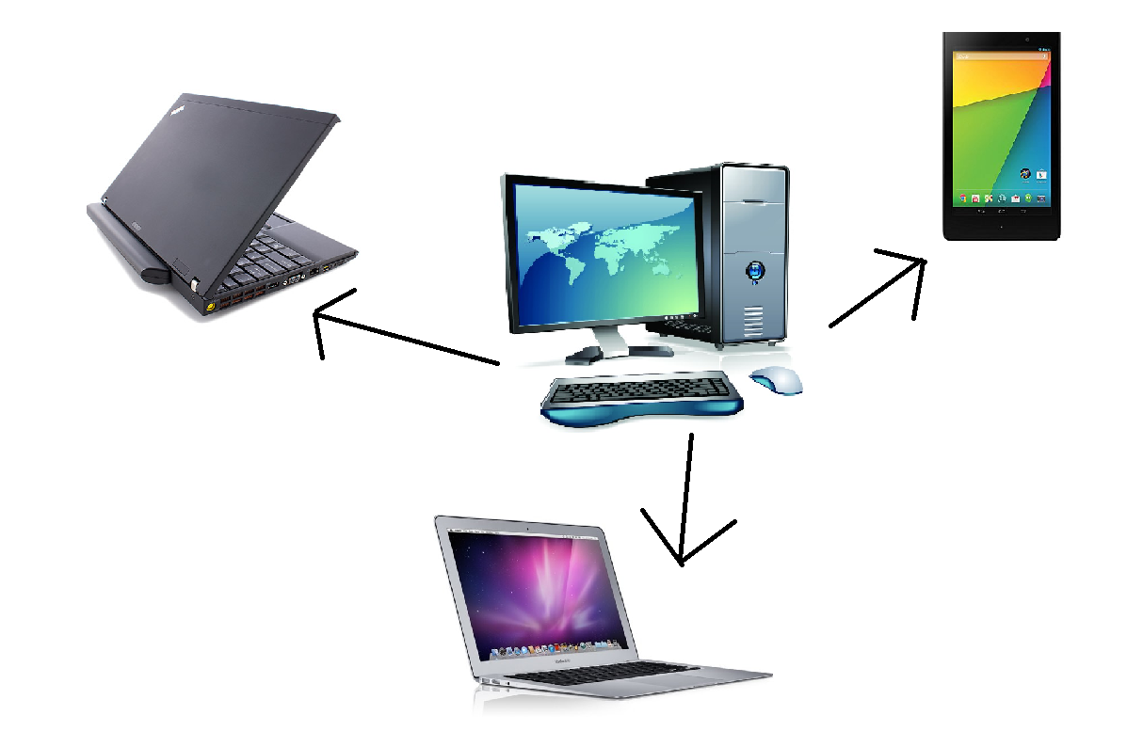
Why Self-Healing Home Networks?
Yuen Hsi Chang
Advisor: Amy Csizmar Dalal
Abstract
Approach
Self-healing networks, networks that can detect and fix potential problems before the end user is aware of the problem, have the potential to make high-functioning, well-designed networks available to all home users. They make computer networks more usable and more user-friendly, as well as easier to deploy and manage. These features make self-healing networks especially attractive for the home, as home networks are increasingly as complex or more complex than institutional networks, requiring a high level of technical expertise to deploy and maintain. Our project explores the design of a monitoring system for a self-healing home network, the purpose of which is to deduce the current state of the network. We describe the architecture of the monitoring system, the measurement tools and test-bed we developed and deployed, and some preliminary results on typical and atypical network performance as measured on our test-bed.
We designed a few tools to collect measurements regarding our network, all of which are described below.
We wrote a script that ping the devices on the network, and a program that repeats this periodically and records this onto a text file, allowing us to determine whether our devices are on the network on any given time.
We made a program local to the command center that remotely accesses our laptops and retrieves a list of the running programs.
We modified a tool that was developed a few years ago to measure the quality of flash videos, and record said measurements in a local file in our command center. Data collected by this tool include frames per second, web bandwidth, and audio bandwidth.
Finally, we also designed a command center that makes use of these tools and measures information regarding the network, and records such measurements to a text file. The data is then manually processed and analyzed.
Experiments
We created a test bed with a command center, three laptops, one tablet, and developed tools to calculate and retrieve measurements, as shown by the diagram below. We then collected data for seven days. Below are two of our most relevant graphs that describe the state of the network. The data is recorded between Thursday, July 25th and Saturday, August 3rd, 2013.
Introduction
Ever since the use of the networking space has gotten widespread to home users, many problems regarding network connectivity and stability have surfaced.
Due to the complex structure of the Internet, problems regarding the home network tend to be very difficult to troubleshoot and solve. Problems within the home network include the following
The lack of a residential IT expert
Trouble identifying the source of the problem (device –generated vs application-generated)
Wireless issues can not be solved locally
Ambiguous networking “features” offered by various operating systems
Networking knowledge regarding how to set up a home network and place a router for best access are not readily available
The addition of a “self-healing” function would significantly ease network maintenance, as developing networks to independently recover from connection problems means that expert users would no longer be needed to aid the troubleshooting process.
Future Work
For future work, we came up with a few ideas that could enhance the quality of our data.
It would be interesting to run more experiments controlling packet loss. Our experiment currently assume no packet loss, which is far from a reasonable assumption regarding home networks.
We could collect more data regarding video quality as we collect information regarding bandwidth and ping. We did collect some video quality data, but it was not enough to be able to make any conclusions or see any patterns.
The Android tool that measures network information needs to be modified to update the information continuously, instead of only when the application is on. This information will be useful in understanding the extent to which Android tablets are affected by network conditions in comparison to laptops.
We suggest looking more closely at the data and the analysis of the data and trying to come up with a singular “health score” that incorporates the bandwidth, ping time, and other potentially useful data. Knowing whether or not the devices are experiencing good network quality is an important next step in pushing towards a ‘self-healing’ structure.
Results
We found out a few things.
The Windows laptop and Android tablet are more susceptible to network conditions than devices and have slower performance. This is indicated by the red line and the yellow line.
Running videos seem to correlate with substantially slower ping times; this is probably due to videos requiring higher network overhead.
Bandwidth always decrease around noon, no matter what was running; this is evident from the consistent dips in our bandwidth graph. This is probably caused by our work environment.

